Slide 1


React
A Brief Introduction
By Vladislav Zolotukhin
Notes:
Hello and welcome to a brief introduction to React. In this presentation we will be discussing what React is, how it works and the core features that it provides, how it is used, and how it may benefit the Canadian Army. Please note that this presentation does not delve into the technical aspects of React, so there will be no examples or breakdowns of any code, and technical terms will be avoided as best as possible unless the context absolutely demands them. With that said, there is still a lot of material to cover, and I am excited to accompany you on this journey of learning about how this relatively new and widespread technology can benefit your day-to-day interactions in the virtual space.
React logo: , https://iconduck.com/sets/brand-icons-by-ryan-dimascio

Slide 2



What is React?
Free & Open-Source Technology
Used for Web Development
Breaks down complex information into smaller manageable parts, component-based architecture
Provides a solution for developers to build websites quickly by focusing on reusability, standardization, and fast implementation
Makes it easy to handle situations where what the user sees is dynamic because the underlying data is constantly changing
Notes:
React is a free and open-source technology developed and maintained by Meta, its used for web development and web-based applications. It excels at breaking down complex information into smaller, more manageable parts. This component-based architecture or design is a core principle of React, and it provides solutions for developers to quickly build websites by focusing on the reusability of parts and offering standardized methods for doing things. By deconstructing large problems into smaller ones and reusing solutions, this component-based design also effectively provides a platform conducive to collaboration as many developers can simultaneously work on separate building blocks that eventually come together to form the whole structure. React is also great at handling situations where the UI, or what the user sees, is very dynamic and constantly changing, because it knows when to update the elements on the screen, or ‘react’ to changes in the underlying data. We will touch upon these aspects of React more later in the presentation and explain how they work but first let’s learn about how React came to be and understand its role in modern web development.
Icons used: Construction and tools icons created by sandiatresna – Flaticon, Real estate icons created by Smashicons – Flaticon, Collaboration icons created by Freepik – Flaticon,

Slide 3






History of React
2011
2013
2017
FaxJS created by Jordan Walke, an early React prototype.
React publicly released as open-source
React 16 released
2012
2015
2025
React used to build Instagram website.
AirBNB and Netflix use React. React Native open sourced
One of the most used frameworks among developers worldwide.
Notes:
© Copyright PresentationGO.com – Free Templates & Infographics for PowerPoint and Google Slides React was originally created by Jordan Walke, a software engineer at Meta (then known as Facebook) in response to the need to develop user interfaces that were faster, more dynamic, and more responsive and easier to manage than the current technology. An early protype version of it emerged in 2011 and was known as “FaxJS”. That same year, React was first deployed on Facebook’s news feed.
In 2012, Facebook acquired Instagram and used React to build its website, and React was officially presented at the JSConf US (United States JavaScript Conference) in 2013 where it was open-sourced to the public, meaning it was freely distributed and made available to use. A world tour was commenced in 2014 with the purpose of promoting its use and in 2015 its use was adopted by big companies like Netflix and AirBNB. That same year, React Native, which was started in 2013 as Facebook’s internal Hackathon project and used to develop web apps for specific operating systems such as android and iOS mobile devices was also freely released to the public through GitHub. In 2017, React version 16 was released, completely rewriting the core algorithm to introduce features such as the Virtual DOM which will be discussed in detail later on. The outcome was huge improvements to the performance, responsiveness, scalability and rendering of complex applications. React continued to be supported in the following years as new versions were released to the public, and now almost 12 years later it remains one of the most used tools among developers worldwide

Slide 4
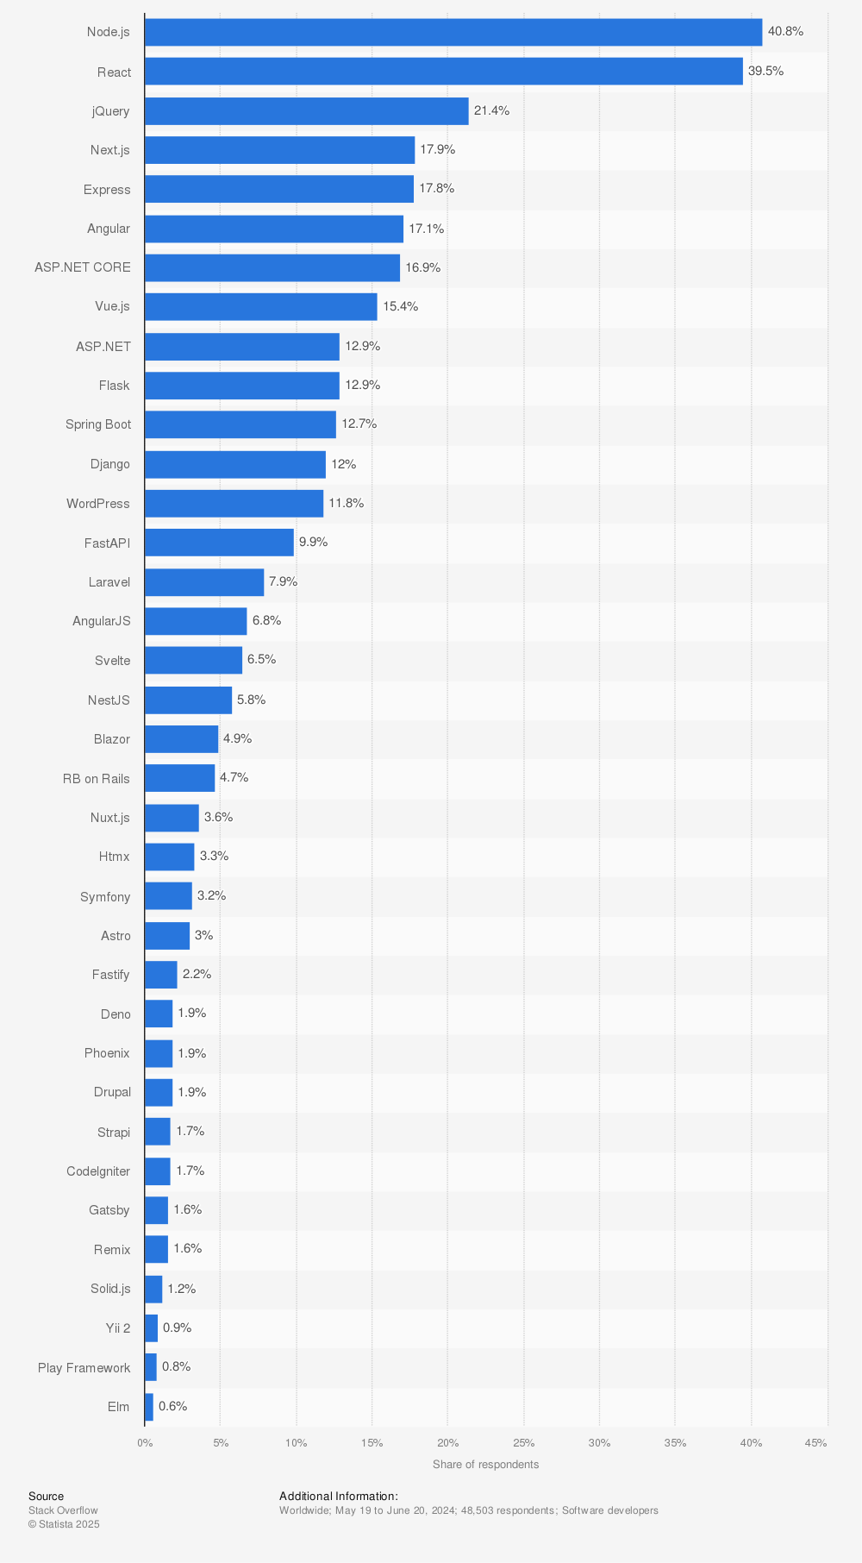
Popularity
Most used web frameworks among developers worldwide (2024)
Notes:
React has remained popular and widespread over the years. In a global poll of over 48,000 software developers by Stack Overflow, React ranked 2nd most used with almost 40% of respondents using it in 2024. https://survey.stackoverflow.co/2024/technology#most-popular-technologies-webframe https://www.statista.com/statistics/1124699/worldwide-developer-survey-most-used-frameworks-web/

Slide 5
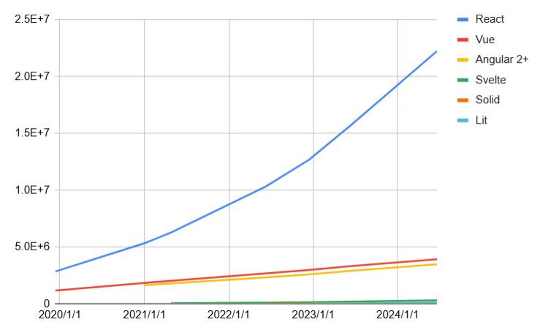
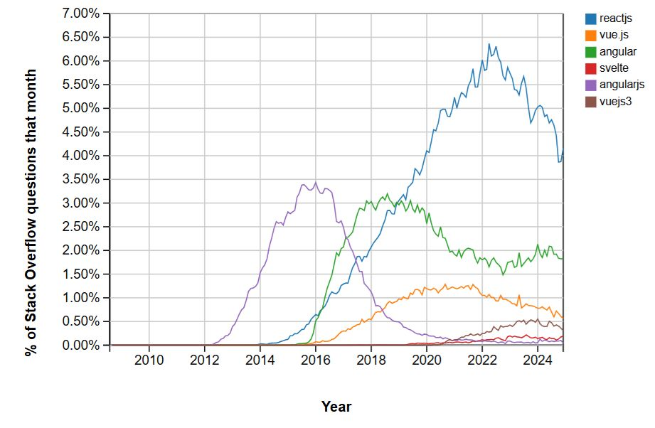
Popularity
GitHub Repositories Using React (2024/6/19)
Stack Overflow Surveys (July 2024)
Notes:
Additional trends corroborate the ongoing popularity of React, such as this data taken from Stack Overflow, a question-and-answer website for programmers, demonstrating that compared to other similar tools, React consistently generates more engagement on a monthly basis.
As of June 19, 2024, more than 22 million repositories on GitHub, a place where people store their files and code related to a project, use React.

Slide 6
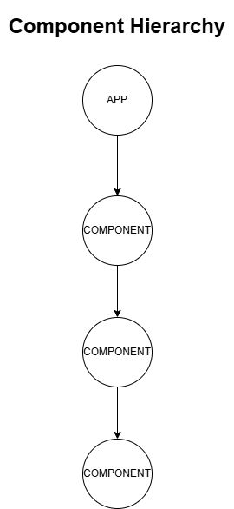




Component Based
Notes:
So why is React so popular? Let's briefly examine the core features that React is based on and what it offers. Earlier, we stated that React uses Component Based Architecture, but what exactly does that mean? React takes the development of something large, like an application, and decomposes it into smaller parts, or components. Those components are then also broken down into smaller components, and so on. A component can be something as simple as an image or a card, serving a specific purpose or function and intended to be reusable throughout the app. In fact, lets expand upon the card analogy. Say instead of building an app, you are building a casino. That casino will have many different games, or components, such as Blackjack, Poker, Slots, and so on. Each of those will be made up of their own parts and have their own rules on how to play. In order to play Texas Hold’em, there must exist a group of players who each possess a hand of cards. The winner of the game is defined by the who has the best hand of cards and still remains in the game, but a hand is also made up of individual cards which have their own defined appearance, and rules Images: https://www.pexels.com/photo/photo-of-scattered-playing-cards-6664193/, https://www.pexels.com/photo/photo-of-a-casino-neon-signage-1435578, 2/, https://www.pexels.com/photo/person-playing-poker-1871508/, https://www.pexels.com/photo/a-gambler-holding-playing-cards-7594302/

Slide 7

Virtual DOM
Tracks changes in the user interface and reduces the time to visually render changes to the website on the screen
Only apply the changes necessary, do not change the whole screen each time some small part is updated
Ensures standard behavior across all browsers
Notes:
The other core feature of React I would like to introduce is the Virtual DOM. DOM stands for Document Object Module, now I said I wasn’t going to get into technical explanations so instead I’ll just state why this is important and give a real-world analogy to how it works. It’s intended to reduce rendering time, the delay between when something on the website you’re viewing is changed and when you can see the change. It does this by keeping a lightweight virtual representation of what the contents of what you’re seeing should look like, and compares them with what it previously looked like. When differences are identified, meaning something changed, it makes only the necessary changes to the content you’re actually seeing by a process called reconciliation. A practical example how this works would be like going to the supermarket with a shopping list of items to purchase, each time you want to add or remove an item you wouldn’t just go buy everything again since that would be slow and wasteful. Instead you update your shopping list and go buy only the new items that you need. The Virtual DOM is like the shopping list and the supermarket is the actual website, it keeps track of the changes and only the necessary parts are updated rather than the whole thing, making everything quicker and more efficient.
Image: https://www.dreamstime.com/royalty-free-stock-images-shopping-cart-supermarket-transition-shelves-image30701259

Slide 8
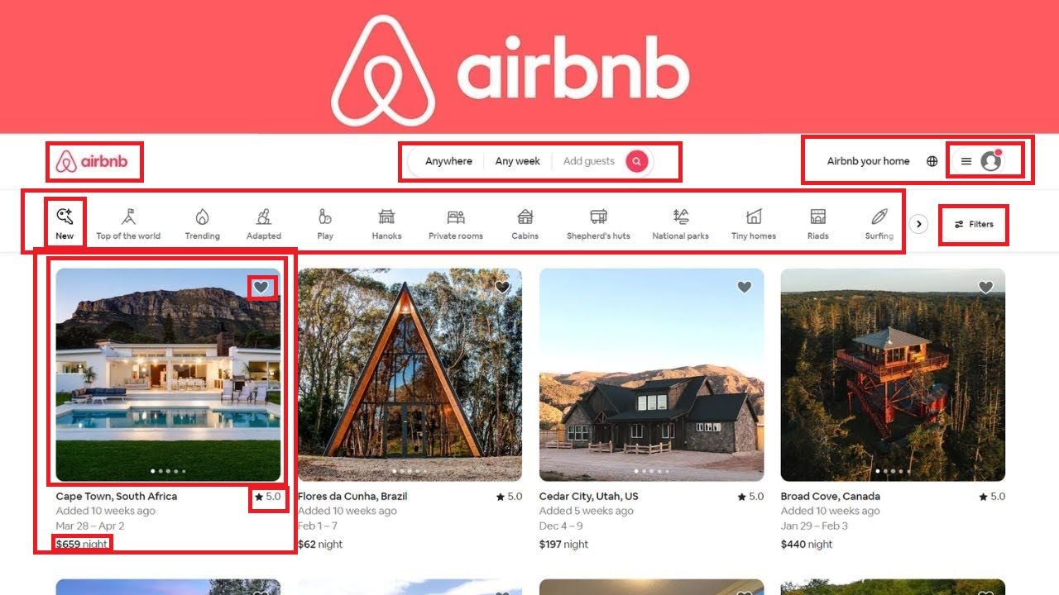
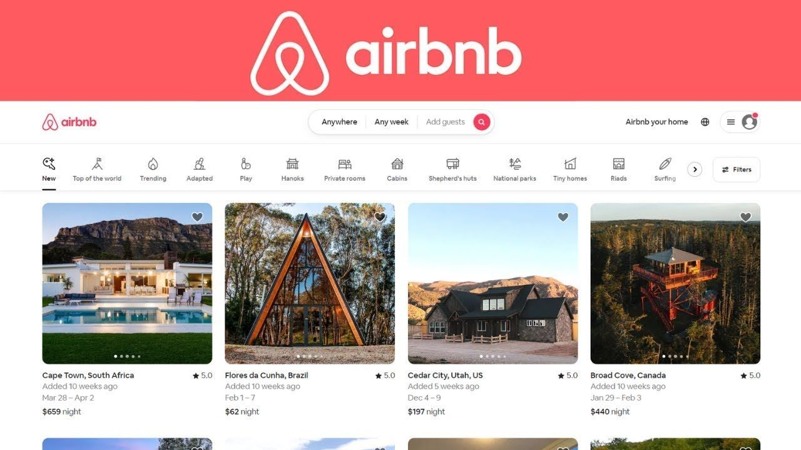
AirBNB React Page
Notes:
Now that you’re familiar with React and its core features, here’s an example of a website that was designed using it. What would your needs be as a user who clicks on this website to look for a location to stay? Can you identify some components visible on the screen? While there seem to be many things shown here, there’s also lots of repetition. Here are just some of the components that make up what you see as the website. There’s a gallery of locations with a slide show of photographs, and pertinent information like the location and the rating. Even small things like the Airbnb logo and text or the rating symbol and value are used throughout this website. They aren’t redesigned from scratch or copy and pasted – each instance corresponds to a single component which is reused in different places. When you want to change something, like maybe the spacing between the star symbol and the rating value or how big the filter icons are, you only need to do it in one place within the component itself and it will instantly reflect everywhere else. Also because of the Virtual DOM, whenever you change something that appear on the screen by searching or applying any combination of the filters that you see, its done very quickly because only the locations that you see need to be updated instead of the entire screen.

Slide 9

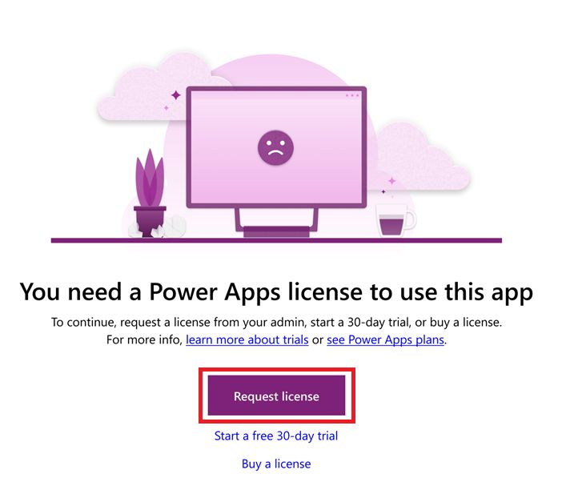

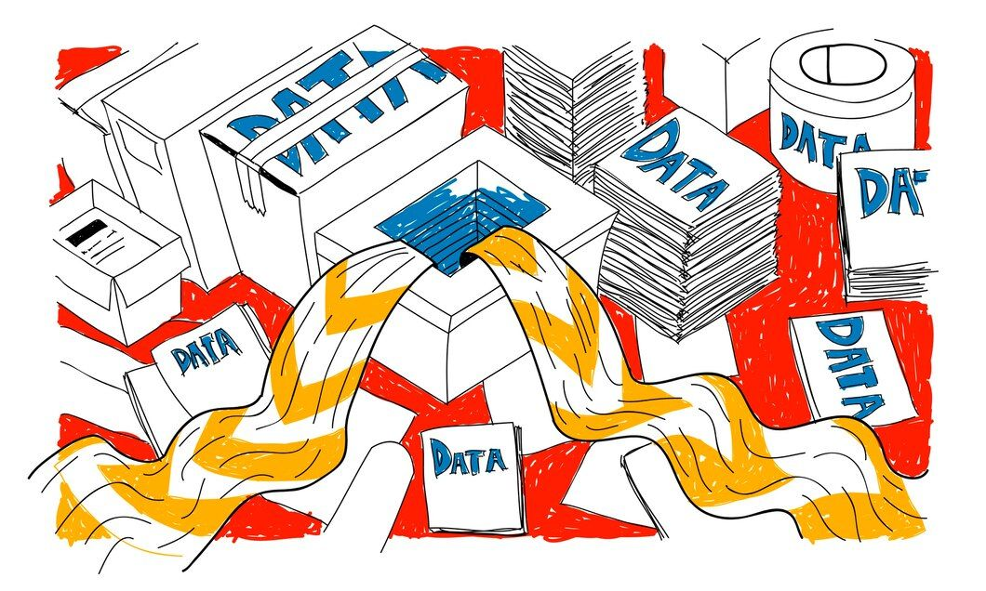
Canadian Army
Faster load times, better performance
Open-source and free to use, does not require a premium license
More flexibility and strong community support
Can handle large volumes of data updates
Great for dynamic and complicated interfaces with lots of reusable elements that could be used elsewhere
Notes:
React offers many benefits to the Canadian Army. It’s fast loading times and performance optimizations are a stark contrast to the issues that military and civilian members of the army frequently experience with software like Microsoft Power Apps, and it doesn’t need any sort of license or monthly subscription to use. It’s much more flexible, offers greater scalability, and can handle large volumes of data updates, which is perfect for innovation and expansion, such as when an application gets adopted by other Divisions and needs to quickly grow, or to easily be customizable to adapt to changing requirements and new features. It also integrates really well to working with many standardized elements and a well-defined structure and offers many security features, both which strongly align with the Canadian Army. Unlike Power Apps, it can also be customized to work with any database, meaning it isn’t relegated to using SharePoint or Dataverse for storing data. React presents a strong use case for adoption as the Canadian Army has increasing needs for tools that can build fast, flexible and large-scale apps that can be easily customizable and work across many different plarforms databases. Images: Designed by Freepik (https://www.freepik.com), https://learn.microsoft.com/, https://upload.wikimedia.org/wikipedia/commons/2/2c/Maple_leaf_transparent.png

Slide 10
Thank You
CITATIONS
The 10 most famous websites built with react. RubyGarage. (n.d.). https://rubygarage.org/blog/websites-built-with-react
7 things about REACT 16 your team should know: Pusher blog. Pusher. (n.d.). https://pusher.com/blog/7-things-about-react-16/#asynchronous-rendering
Airbnb Engineering & Data science. Airbnb Engineering & Data Science. (n.d.). https://airbnb.io/
Author, G. (2022, July 14). What is react.js? introduction and definition. Code Institute Global. https://codeinstitute.net/global/blog/what-is-react-js/#:~:text=Coding-,React.,source%20community%20now%20maintain%20it.
The best guide to ReactJs - Optimal Virtual employee. Optimal Virtual Employee -. (2023, February 22). https://www.optimalvirtualemployee.com/blog/the-best-guide-to-reactjs-for-beginners/
Compare power apps vs react 2025. TrustRadius. (n.d.). https://www.trustradius.com/compare-products/powerapps-vs-react#community-pulse
A must-read guide to react native development for 2022. GoodFirms. (2025, February 13). https://www.goodfirms.co/blog/react-native-development-in-2022
Front-end frameworks popularity (react, Vue, angular and Svelte). Gist. (n.d.). https://gist.github.com/tkrotoff/b1caa4c3a185629299ec234d2314e190
Hámori, F. (2024, May 29). The history of react.js on a timeline. RisingStack Engineering. https://blog.risingstack.com/the-history-of-react-js-on-a-timeline/
ReactJS virtual dom. GeeksforGeeks. (2024, December 12). https://www.geeksforgeeks.org/reactjs-virtual-dom/
Technology. Technology | 2024 Stack Overflow Developer Survey. (n.d.). https://survey.stackoverflow.co/2024/technology#most-popular-technologies-webframe
UXPin. (2024, October 25). 15 examples of Reactjs websites. Studio by UXPin. https://www.uxpin.com/studio/blog/reactjs-websites-examples/
Notes:
Thank you for listening to my presentation about React, I hope that you found it educational and it provided some salient points regarding why React would be a good fit for the Canadian Army. If you wish to do a deep dive on some of the information presented here, please refer to the list of references provided on this screen. I look forward to accompanying you on further educational journeys about topics such as the Gemini AI Model.

